Slide 1
Summer’24

Slide 2
There exists no protocol in the layer 6 & 5.
Functionalities of these two layers are implemented by the Application layer software (e.g., browswer)

Slide 3
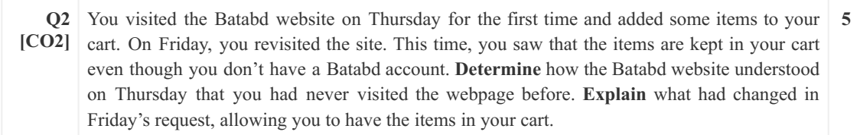
HTTP request did not send a Cookie ID
Server set a Cookie ID on Thursday
on Friday, HTTP request contains a cookie ID.

Slide 4
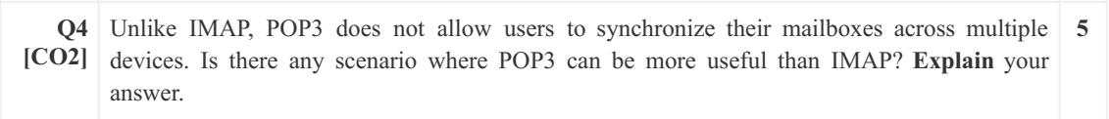
You can access email anytime without Internet

Slide 5
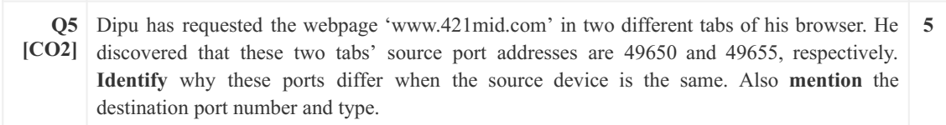
Each tabs are considered as a different processes
When segment arrives from the server, these different destination port allows the client transport layer to identify which tab the segment was sent.
Destination port number: 80

Slide 6
If the server still has data to send.
Then, it will not send FIN even after receiving FIN from the client
In this case, the server can send data while the client cannot

Slide 7
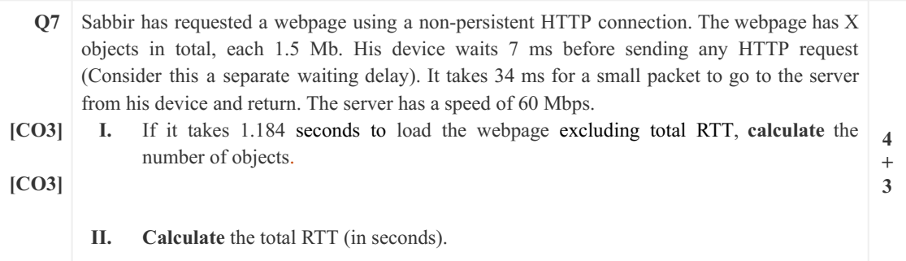
I) Question says, Load time EXCLUDING total RTT
Load time=1.184=(delay before HTTP request+total OTT)
=0.007*N_obj+N_obj*1.5/60)
N_obj=37
II) N_obj*2*RTT=37*2*34

Slide 8
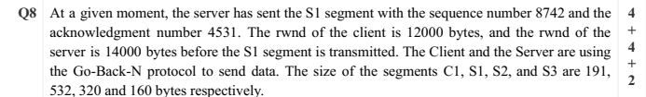
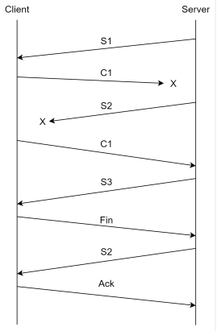
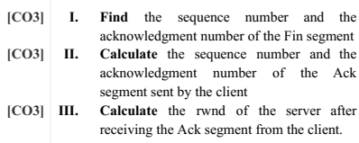
I)Fin_seq=4531+191
Fin_ack=8742+532
II) C_ack_seq=4531+191+1
C_ack_ack=8742+532+320
III) 14000-191

